Slide 1
Data-Driven Insights for Digital Marketing Campaigns
Presented by Shaik Arshiya Fathima

Slide 2
In this project, first of all i have cleaned the data in excel and power bi by transforming the data. I have merged the two sheets of data in one sheet by copy and paste the column called “Users”. I have also applied the formulas of CTR, CPC, ROI, and Conversion Rate.

Slide 3
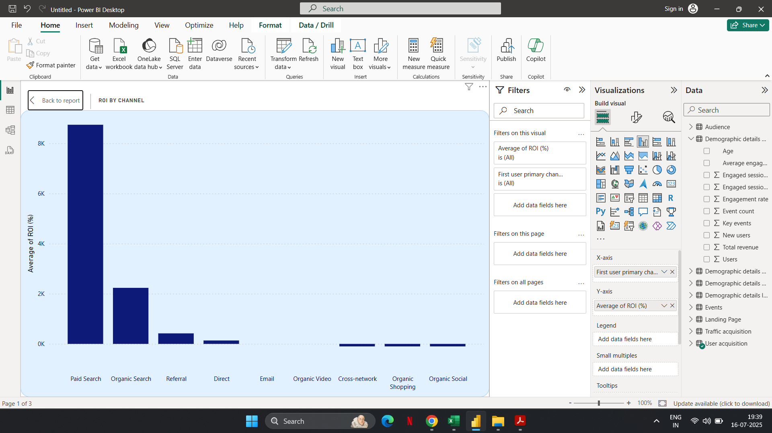
The visualization clearly highlights which channels are generating better ROI performance. Paid Search delivers the highest ROI by a significant margin compared to all other channels.

Slide 4
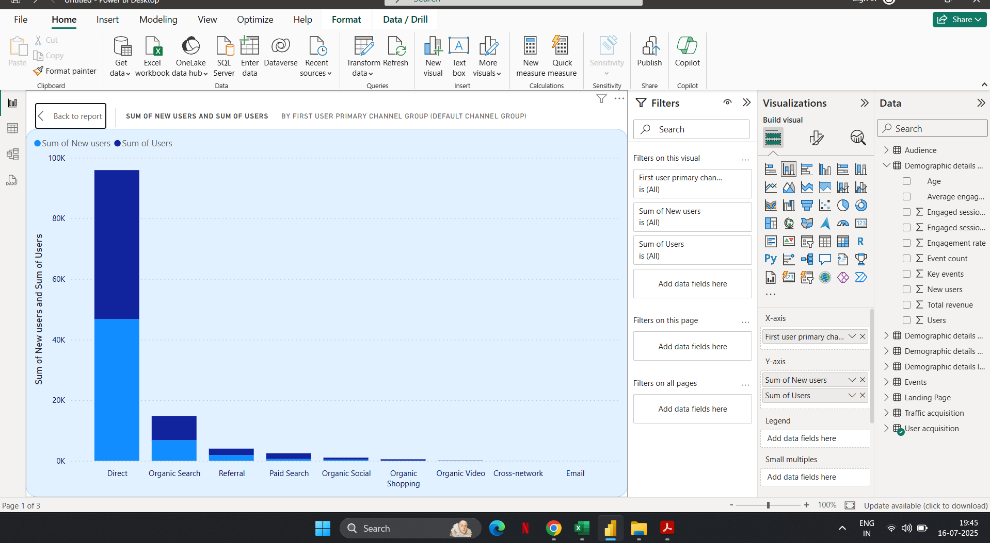
There are two types of users they are Users and New Users. In this Direct Channel group is showing highest no.of total and new users when compared to all other channel groups.

Slide 5
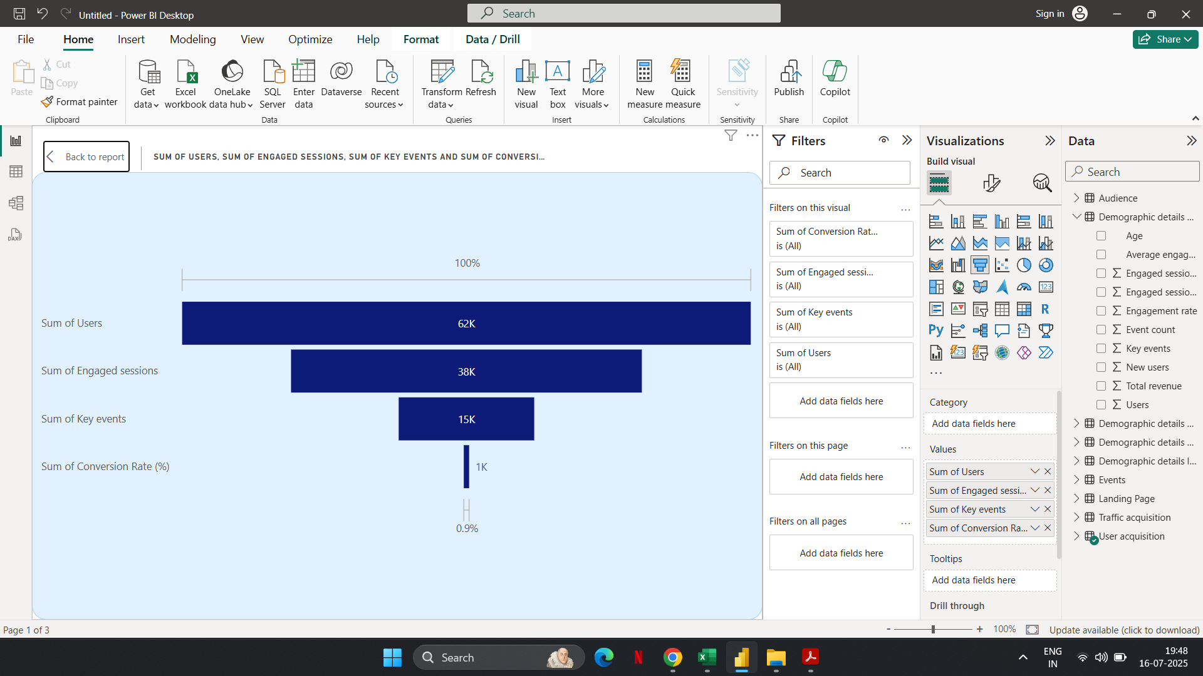
This Funnel Chart displays the user journey through key metrics in a typical digital marketing campaign lifecycle

Slide 6
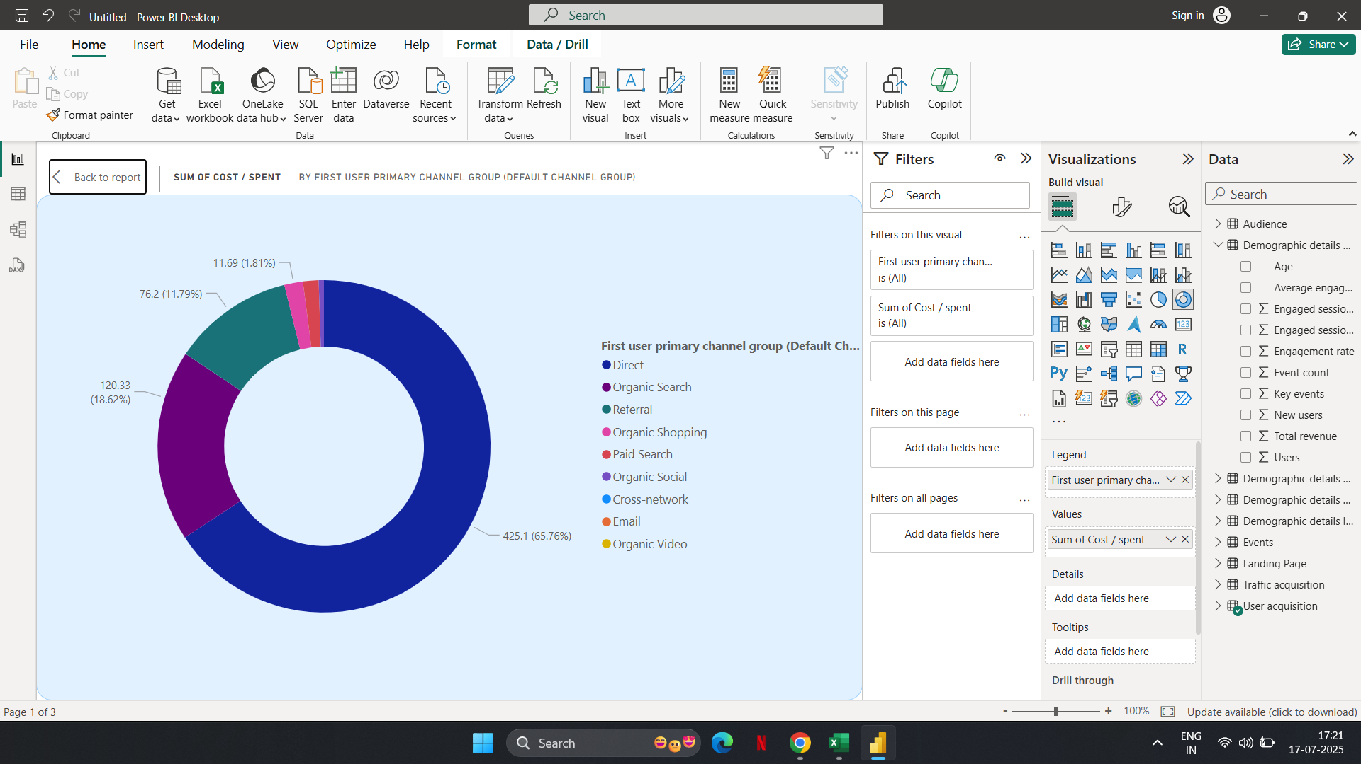
Direct Channel consumes the majority of the budget (65.76%), indicating this is where most resources are being spent.There might be an opportunity to diversify spending to improve acquisition across underutilized channels.

Slide 7
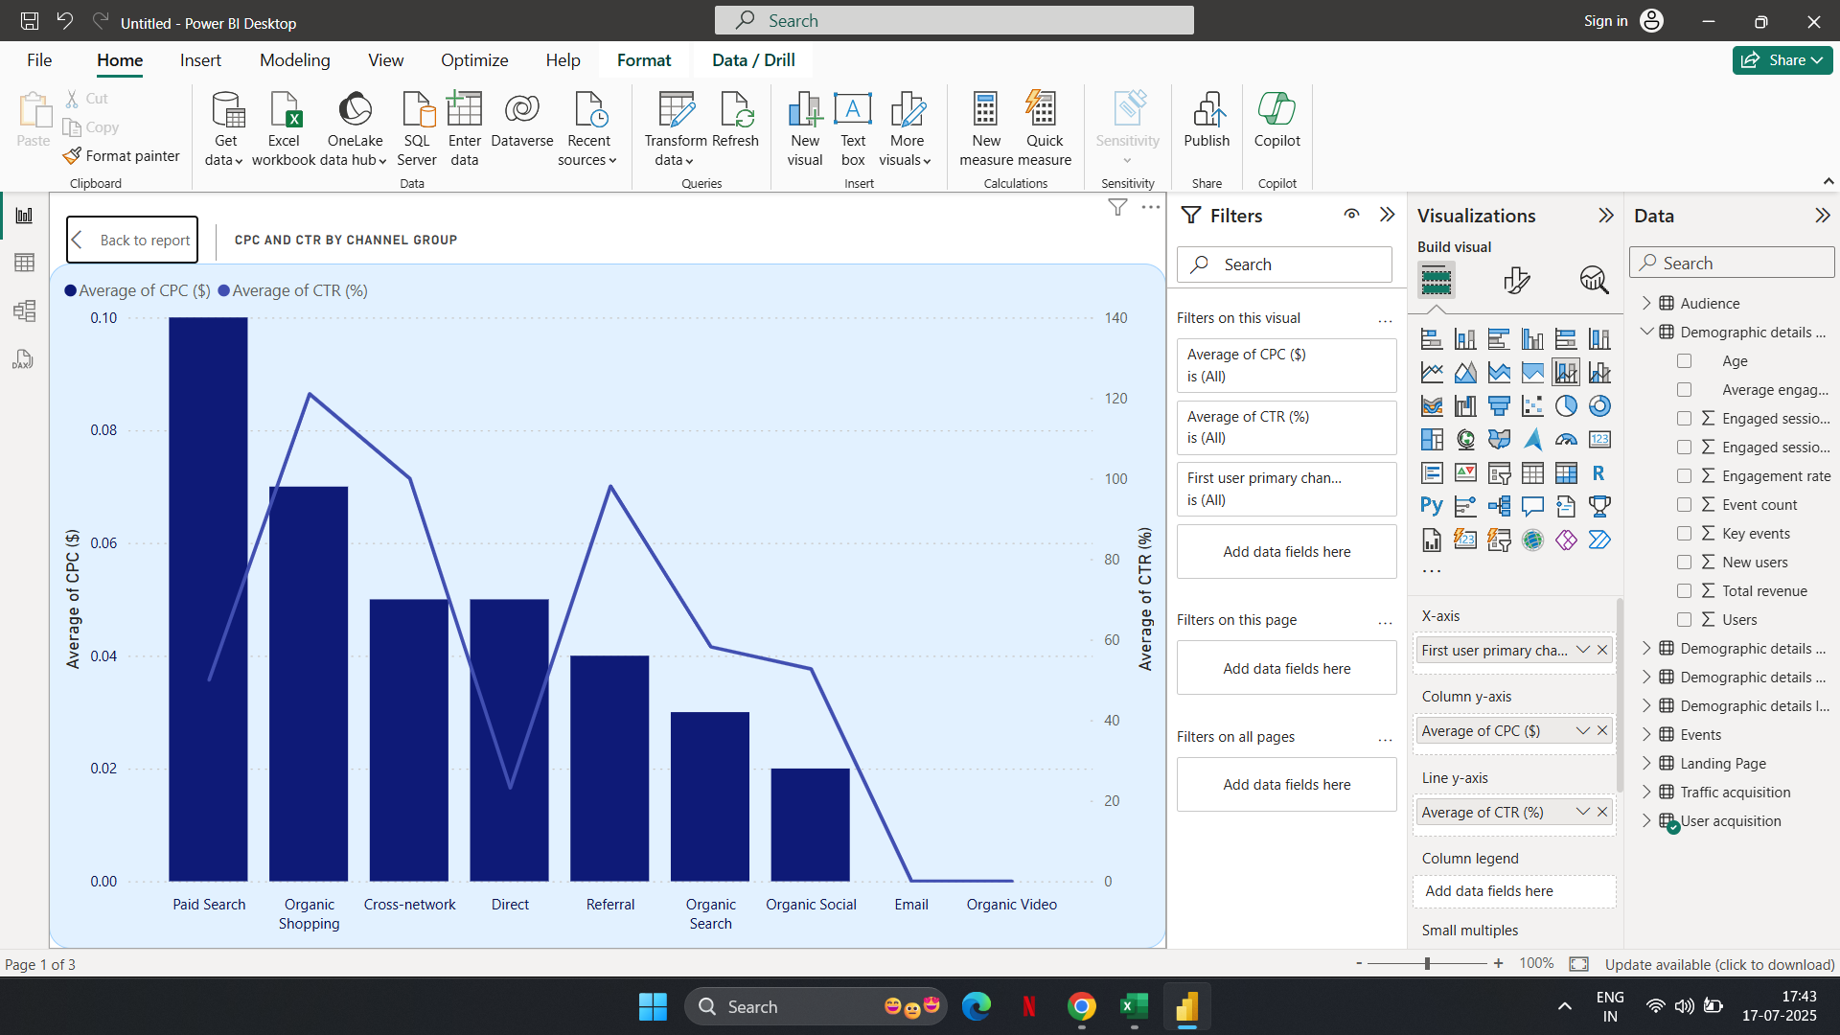
Paid Search has the highest CPC but not the highest CTR — this suggests it may not be the most cost-efficient channel.Organic Shopping & Referral Channels show relatively high CTR despite lower CPC, indicating better engagement for lower spend. Direct Traffic incurs moderate CPC but shows very low CTR, suggesting inefficiency in driving engagement.Email & Organic Video show negligible CPC and CTR, indicating poor performance or underutilization.Cross-Network delivers a strong CTR for moderate CPC, indicating an opportunity to scale this channel.

Slide 8
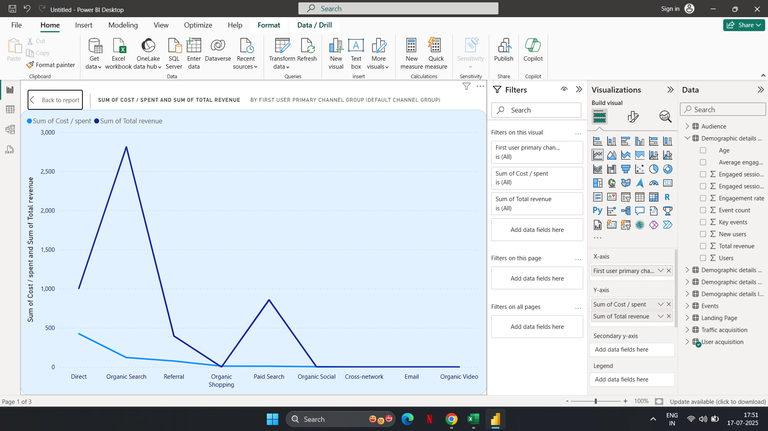
Organic Search delivers the highest revenue with minimal cost — this is the most cost-efficient channel.Referral shows low spending and low revenue, offering limited impact.

Slide 9
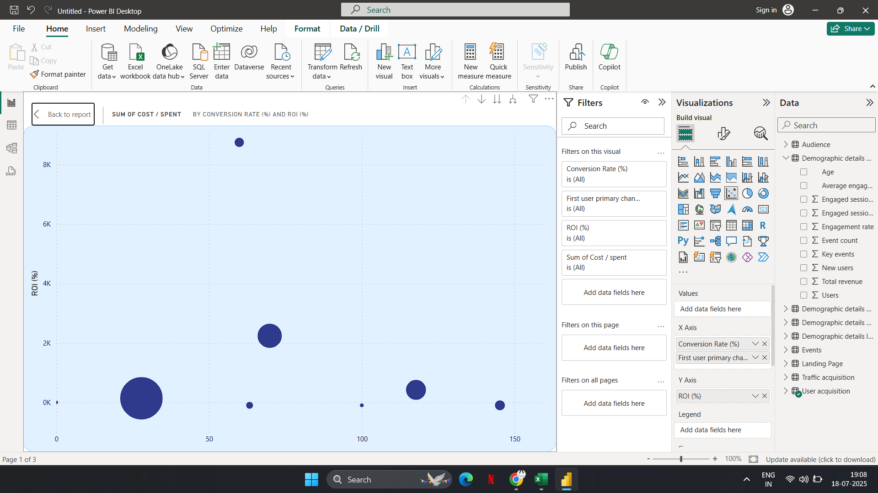
Large Bubble, High X & Y values High conversion, high ROI, high spend — these are your best-performing campaigns.Small Bubbles: Represent campaigns with relatively low spend, regardless of performance. Outliers: Any bubbles far from the cluster may represent unique behaviors worth investigating further.
Organic Search delivers the highest revenue with minimal cost — this is the most cost-efficient channel.Referral shows low spending and low revenue, offering limited impact.

Slide 10
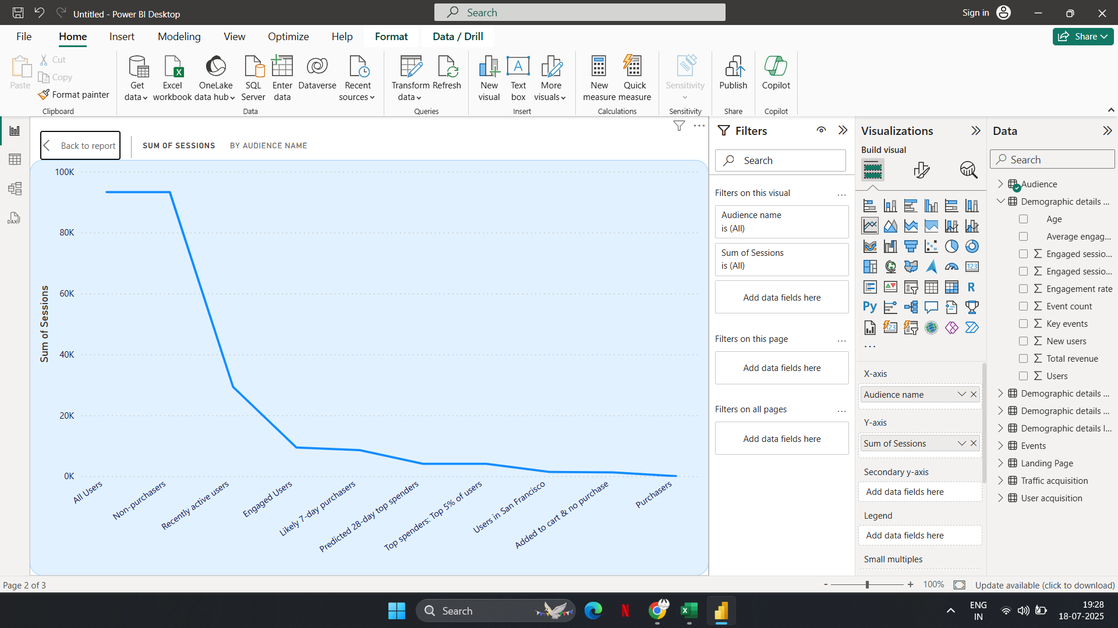
The number of sessions drastically decreases from "All Users" to "Purchasers"."All Users" and "Non-purchasers" dominate the sessions count, meaning most website traffic comes from users who do not make purchases.

Slide 11
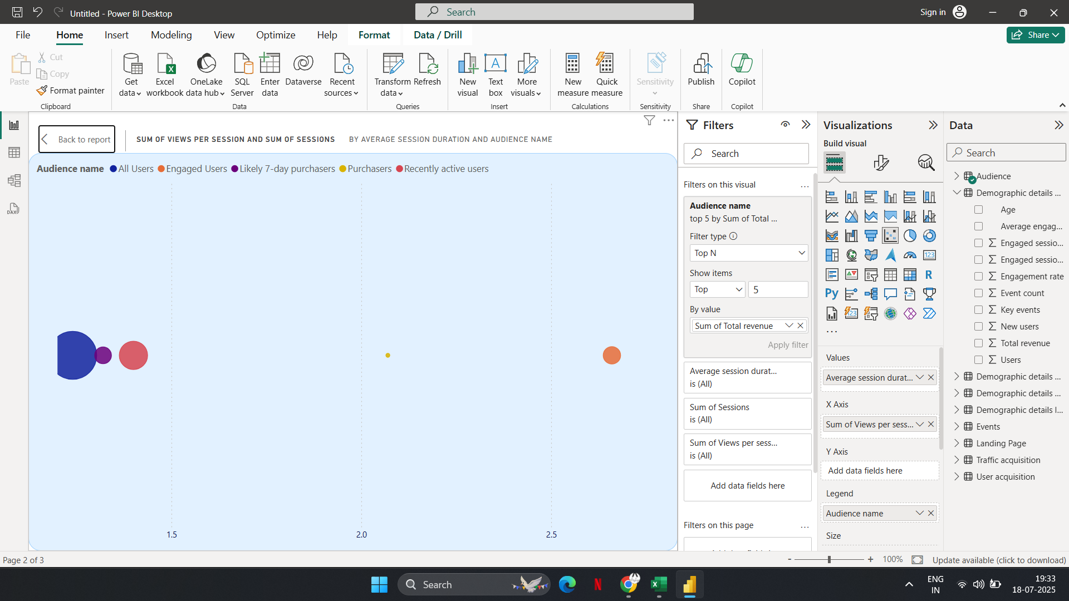
This chart helps you visually analyze how different audience segments behave in terms of: Time Spent (Engagement Duration),Depth of Interaction (Views per Session),Volume of Activity (Number of Sessions)
Focus on Increasing Depth for 'All Users' and 'Engaged Users': Encourage these groups to view more pages and spend more time — optimize site journeys, CTAs, and recommendations.🔹 Optimize for 'Purchasers': Analyze what content or features keep them engaged and replicate that strategy across other user segments.🔹 Re-evaluate 'Likely 7-Day Purchasers': Consider whether predictive models are accurate or whether this segment needs further refinement.🔹 Improve Engagement for 'Recently Active Users': Retarget these users with personalized campaigns to convert them into purchasers.

Slide 12
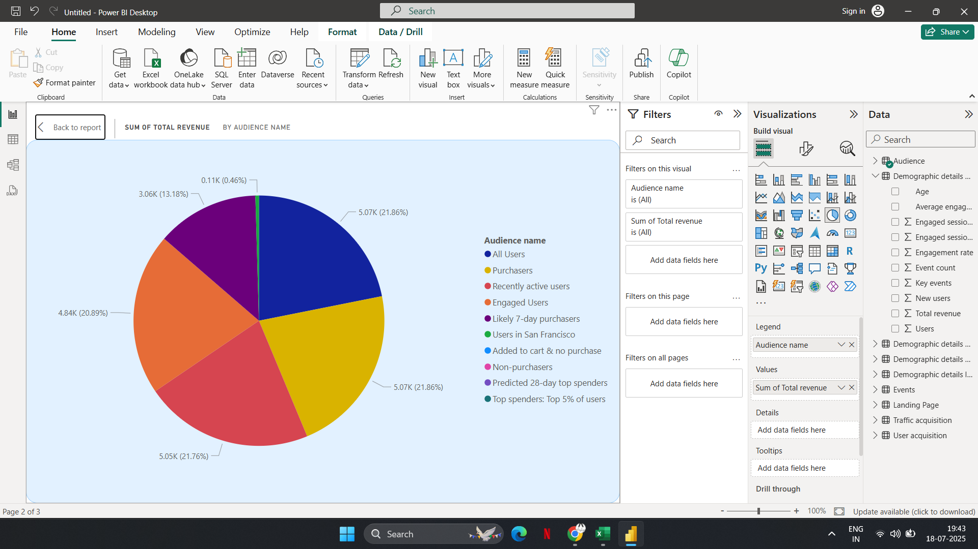
Purchasers (Yellow) and All Users (Blue) contribute the largest share of total revenue (~21.86% each).'All Users' shows high revenue share likely because it overlaps with Purchasers. However, this segment is broad and may include less efficient sub-groups.'Likely 7-day purchasers' contribute less than expected (13%) — there may be opportunities to better nurture and convert this group.

Slide 13
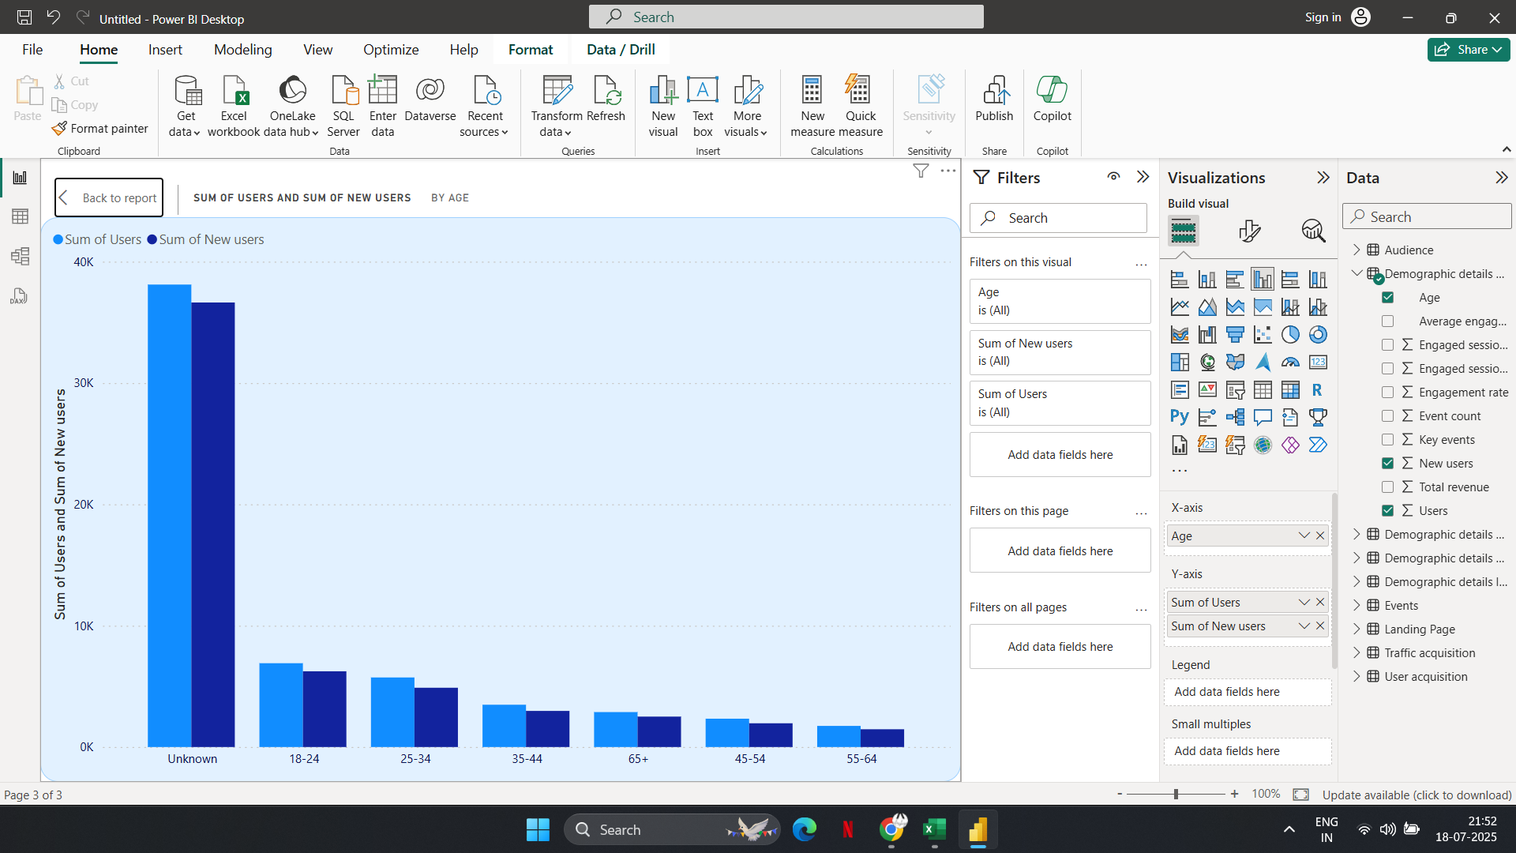

Slide 14
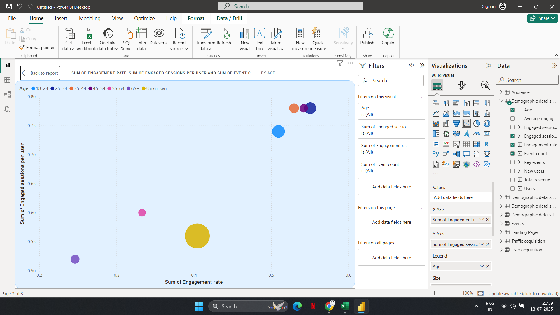

Slide 15
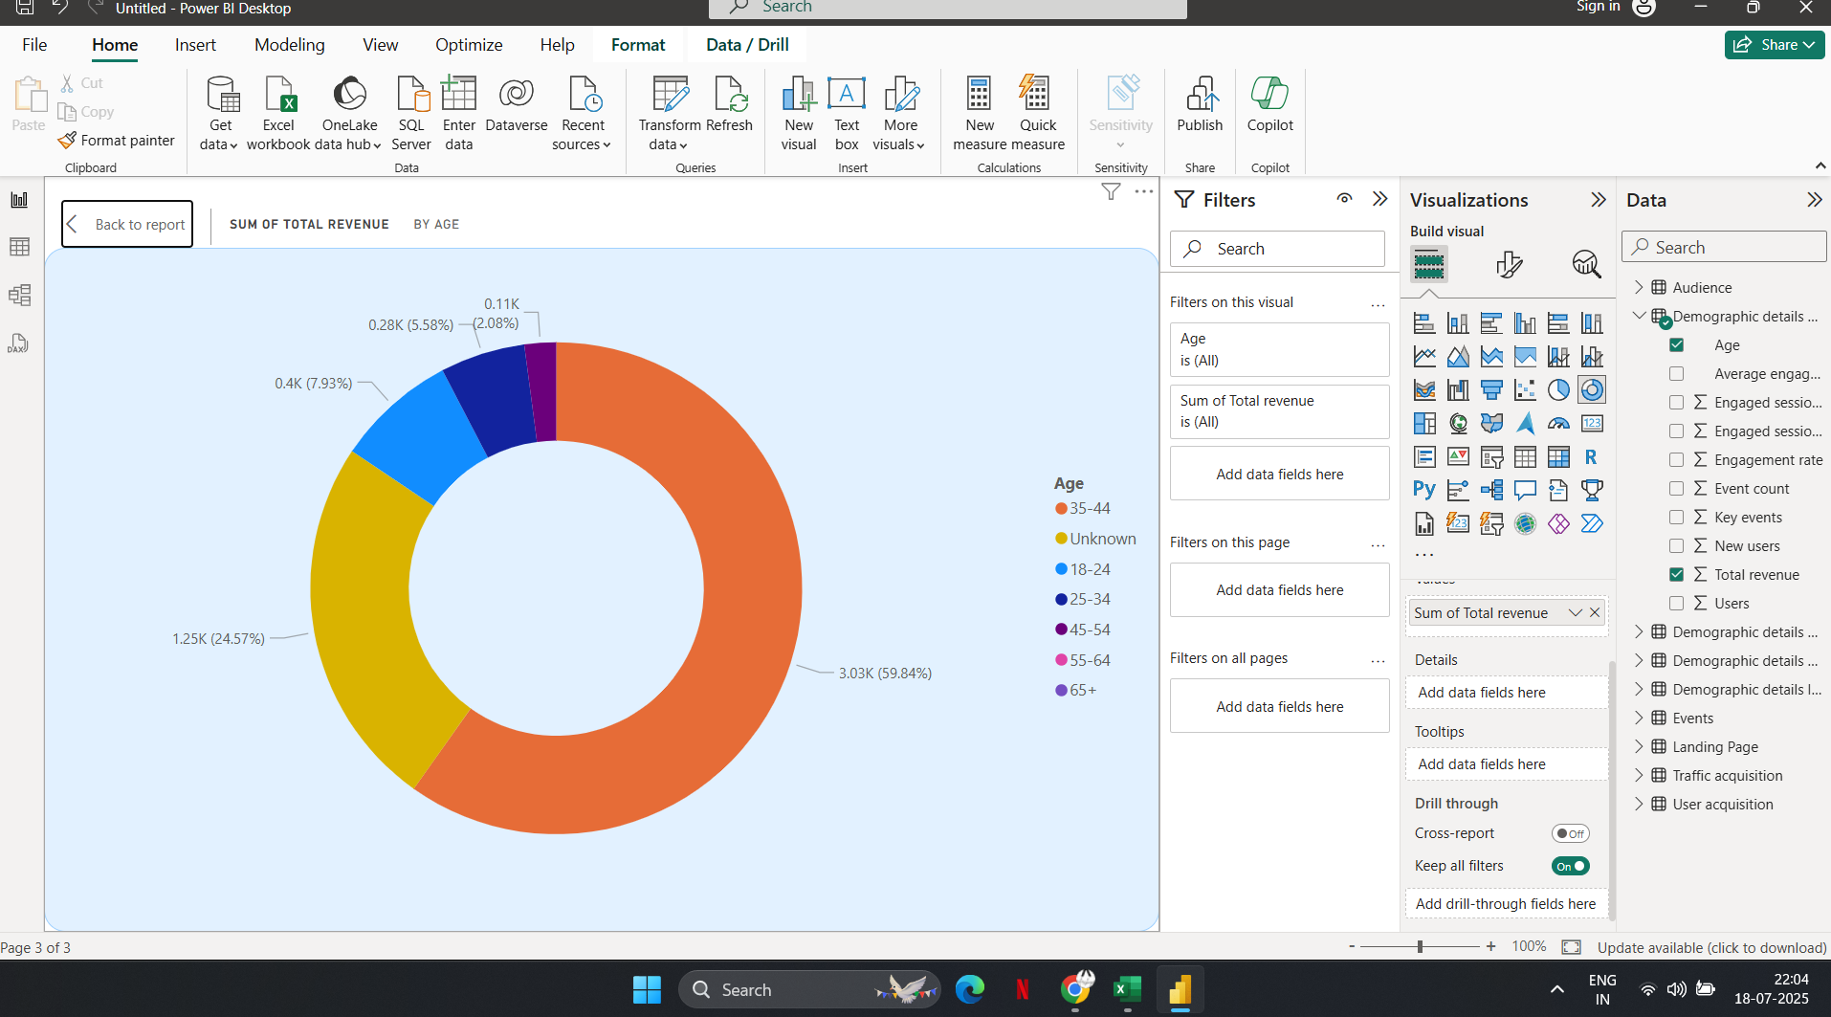
The "Unknown" group is too large for effective long-term strategy. Invest in better data collection through mandatory fields, incentives, or account setups.

Slide 16
Recommendations
Prioritize Data Collection Improvements: Reduce the size of the "Unknown" age group (currently contributing ~60% revenue) through better data capture strategies like mandatory age fields, surveys, or registration prompts.
Focus on the 35-44 Age Segment: This age group is your strongest known revenue driver (~25%). Tailor marketing, product offerings, and engagement strategies specifically to this demographic.
Enhance Conversion for 18-34 Age Group: Though engagement is good, revenue contribution is modest. Develop targeted strategies (offers, pricing models, loyalty programs) to increase spend and conversion rates within this younger audience.
Limit Investment in 45+ Age Groups: The 45+ demographic shows minimal revenue impact. Unless aligned with strategic goals, deprioritize heavy marketing spend here.
Monitor and Analyze the "Unknown" Group Behavior: Since this group is generating the majority of revenue without demographic clarity, conduct behavioral analysis (device, location, session patterns) to shape indirect strategies until better data is available.

